Slide 1
Subject: data structure
sE (cMPN/inft)
Prof. Swapnil s. Sonawane (SSs)

Slide 2
https://drive.google.com/drive/folders/1wAo_UntjVzfWoYn5UfvprsbMOFBsU6JH?usp=sharing

Slide 3
What is Data Structure:
If the data is very huge, we need to organize that data properly, so that we can access it efficiently and the mechanism which is used for arranging such data is called as Data Structure

Slide 4
Types of Data Structure:
Following are 2 types of data structure:
1. Primitive data structure:
It contains those data types which are already created by programming language
Example: int, float, char etc.
2. Non-Primitive data structure:
It contains those data structures which are created by combining different primitive data structures.
It has 2 types:

Slide 5
a. Linear data structure:
If the data is arranged in linear or sequential manner, then it is called as linear data structure
It has 2 types:
i. Static data structure:
It contains those data structure which has fix memory size
Example: array
ii. Dynamic data structure:
It contains those data structure, whose size can be dynamically updated during run time.
Example: Stack, Queue, Linked list etc.

Slide 6
b. Non-Linear data structure:
If the data is arranged in non-linear or hierarchical manner, then it is called as non linear data structure
Example: Tree, Graph etc.

Slide 7
Operations on data structure:
Operation | Description
Traversing | In this we can traverse or move from one element to another element in data structure
Searching | In this, we can check whether element in data structure is present or not
Insertion | In this, we can add or insert new element in data structure
Deletion | In this, we can delete or remove existing element from data structure
Sorting | In this, we can arrange elements of data structure in ascending or descending order
Merging | In this, we can join or merge 2 or more data structures.

Slide 8
Stack:
A Stack is a linear data structure that follows the LIFO (Last-In-First-Out) principle.
It contains only one pointer TOP pointing to the topmost element of the stack.
Whenever an element is added in the stack, it is added on the top of the stack, and only the top element can be deleted from the stack.
Insertion of new element into stack is called as PUSH operation, whereas deletion of existing element from stack is called as POP operation
PEEK operation represents retrieving topmost element from stack
While pushing element into stack we need to check “Stack Overflow” condition and while popping element from stack we need to check “Stack Underflow” condition

Slide 9
Abstract data type:
It is special kind of datatype, whose behavior is defined by a set of values and set of operations.
The keyword “Abstract” is used as we can use these datatypes, to perform different operations, but how those operations are working that is totally hidden from the user.

Slide 10
Example: ADT of Stack
PUSH Operation
Let ‘s’ is the stack with size ‘N’ and ‘x’ be the element inserted in a stack
if(top==N-1)
print “Stack Overflow”
else
top=top+1
s[top]=x

Slide 11
POP Operation
Let ‘s’ is the stack with size ‘N’
if(top== -1)
print “Stack Underflow”
else
x=s[top]
top=top-1
print “x as deleted element”

Slide 12
Program:
Write a program to implement stack using array to perform following operations on stack
Push new element into stack
Pop existing element from stack
Peek topmost element from stack
Display contents of stack

Slide 13
Application of Stack:
Reversing a String:
While reversing a string, we can push different characters of string into stack and after pushing all characters, we start popping every character from stack one by one, to get reverse of string
Example:
Number Conversion:
Stack is also used to convert decimal number to binary or octal or hexadecimal. In that case we need to store all reminders into stack and at the end pop all reminders from stack to get appropriate converted value of decimal number
Example:

Slide 14
Recursion:
When a function calls itself repeatedly, it is called as “Recursion”.
Recursive functions use something called “the call stack.” When a program calls a function, that function goes on top of the call stack. Then, when termination condition meets the values take off from top of stack.
Example:

Slide 15
Checking Correctness of Parenthesis:
A stack is a very effective data structure for evaluating arithmetic expressions for checking correctness of parenthesis in programming languages.
In addition to operands and operators, the arithmetic expression may also include parenthesis like "left parenthesis" and "right parenthesis". When left parenthesis occurs, we can push it into stack and when right parenthesis occurs, we can pop left parenthesis to check correctness.
Example: A + (B - C)
Program:
Write a program to check correctness of parenthesis of input expression using stack

Slide 16
Polish Notation:
Stack is used to convert and evaluate following 3 types notations:
1. Infix Notation: In this, operator is used in between operands
Example: A+B
2. Prefix Notation: In this, operator is used before operands
Example: +AB
3. Postfix Notation: In this, operator is used after operands
Example: AB+

Slide 17
Infix to Postfix Conversion:
A + B * C
M * N – J + K
Q – J * A + D / F – M * R
M * J – (N + D ) / F * W + Z

Slide 18
M * J - ( N + D ) / F * W + Z
Infix | Stack | Postfix
M
*
J
-
(
N
+
D
)
/
F
*
W
+
Z

Slide 19
Algorithm:
Scan the expression from left to right
If operand is encountered, then add it to the postfix expression
If left parenthesis ‘(’ encountered, then push it into the stack
If operator encountered then repeatedly pop element from stack and add it to postfix, if incoming operator has less than or equal priority than stack top and add incoming operator to stack
If right parenthesis ‘)’ encountered, then repeatedly pop element from stack and add it to postfix till left parenthesis ‘(’ encounters and remove left parenthesis.

Slide 20
Infix to Prefix Conversion:
M * N – J + K
Q – J * A + D / F – M * R
M * J - ( N + D ) / F * W + Z

Slide 21
Algorithm:
Scan the expression from right to left
If operand is encountered, then add it to the prefix expression
If right parenthesis ‘)’ encountered, then push it into the stack
If operator encountered then repeatedly pop element from stack and add it to prefix, if incoming operator has less priority than stack top and add incoming operator to stack
If left parenthesis ‘(’ encountered, then repeatedly pop element from stack and add it to prefix till right parenthesis ‘)’ encounters and remove right parenthesis.

Slide 22

M * J - ( N + D ) / F * W + Z
Infix | Stack | Prefix
Z
+
W
*
F
/
)
D
+
N
(
-
J
*
M

Slide 23
Evaluation of Postfix Expression:
Algorithm:
1. Scan expression from left to right
2. If operand encounters, add it to the stack
3. If operator encounters, then:
a. Pop two operands from stack and perform the operation
b. Push the result into the stack

Slide 24
Queue:
A Queue is a linear data structure that follows the FIFO (First-In-First-Out) principle.
It contains two pointers i.e., front and rear
Whenever an element is added in the queue, it is added from rear end and an element can be deleted from front end
Insertion of new element into queue is called as ENQUEUE operation, whereas deletion of existing element from queue is called as DEQUEUE operation
While pushing element into queue we need to check “Queue Overflow” condition and while deleting element from queue we need to check “Queue Underflow” condition

Slide 25
Example: ADT of Queue
ENQUEUE Operation
Let ‘q’ is the queue with size ‘N’ and ‘x’ be the element inserted in a queue
if(rear==N-1)
print “Queue Overflow”
else
rear=rear+1
q[rear]=x

Slide 26
DEQUEUE Operation
Let ‘q’ is the queue with size ‘N’
if(front==rear+1)
print “Queue Underflow”
else
x=q[front]
front=front+1
print “x as deleted element”

Slide 27
Program:
Write a program to implement queue using array to perform following operations on queue
Insert new element into queue
Delete existing element from queue
Display contents of queue

Slide 28
Circular Queue:
There was one limitation in the array implementation of Queue.
If the rear reaches to the end position of the Queue, then there might be possibility that some vacant spaces are left in the beginning which cannot be utilized.
So, to overcome such limitations, the concept of the circular queue was introduced.
A circular queue is similar to a linear queue as it is also based on the FIFO (First In First Out) principle except that the last position is connected to the first position in a circular queue that forms a circle.
It is also known as a Ring Buffer.

Slide 29
Program:
Write a program to implement circular queue to perform following operations:
Insert new element into queue
Delete existing element from queue
Display contents of queue

Slide 30
Priority Queue:
It is a special type of queue in which elements will be processed based on their priority
It has 2 types:
1. Ascending priority queue: In this processing of elements of queue will be done in lower to higher priority
2. Descending priority queue: In this processing of elements of queue will be done in higher to lower priority
Normally we use Descending priority queue in which element with higher priority will be processed before element with lower priority
If 2 or more elements have same priority then they will be processed in FIFO manner and if priority is not mentioned then, value of element will be considered as its priority.
Priority queue can be implemented in 2 ways:

Slide 31
1. Priority queue with normal insert:
In this, insertion of element in queue will be done normally, but while deletion, we delete element with high priority before the element with low priority.
2. Priority queue with normal delete:
In this, while inserting element in queue, we insert it based on its priority, in descending order, whereas deletion of element from queue will be done normally

Slide 32
Double Ended Queue (DEQUE):
Deque is a linear data structure in which the insertion and deletion operations are performed from both ends.
There are two types of DEQUE:
1. Input-restricted queue:
In input-restricted queue, the insertion is applied to one end while the deletion is applied from both the ends.
2. Output-restricted queue:
In an output-restricted queue, the deletion can be applied only from one end, whereas the insertion is possible from both ends.

Slide 33
Linked list/ Linear linked list/ Singly linked list:
A linked list is a linear of data structures, which contains different “nodes”, and they are connected via links.
Every node of linked list contains following:
Data: It represents data of that current node
Next: It represents address of next node
Linked list can be accessed by “start” pointer which points to starting node of linked list.
The “next” part of last node is always “NULL” in linear linked list

Slide 34
Program:
Write a program to implement linear linked list to perform following operations:
Insert new node at beginning
Insert new node at end
Insert new node at specific position
Delete node from beginning
Delete node from end
Delete node from specific position
Count number of nodes
Search particular node
Sort linked list
Reverse the list
Display all nodes of linked list

Slide 35
Doubly Linked List:
A doubly linked list is a linear of data structures, which an be accessed in both directions i.e., forward as well as backward direction.
Every node of linked list contains following:
Data: It represents data of that current node
Next: It represents address of next node
Prev: It represents address of previous node
Linked list can be accessed by “start” pointer which points to starting node of linked list.
The “next” part of last node and previous part of starting node is always “NULL” in doubly linked list

Slide 36
Program:
Write a program to implement doubly linked list to perform following operations:
Insert new node at beginning
Insert new node at end
Delete node from beginning
Delete node from end
Display all nodes of linked list

Slide 37
Circular Linked List:
In a circular Singly linked list, the last node of the list contains a pointer to the first node of the list, it means the last node’s next pointer stores the address of first node of the linked list.
The circular liked list has no beginning and no ending. There is no null value present in the next part of any of the nodes.
Normally circular linked list will be accessed using last pointer which points to last node of circular linked list, so that insertion and deletion operations will become easier at beginning as well as at the end

Slide 38
Program:
Write a program to implement circular linked list to perform following operations:
Insert new node at beginning
Insert new node at end
Delete node from beginning
Delete node from end
Display all nodes of linked list

Slide 39

Program:
Write a program to implement stack using linked list
OR
Write a program to perform linked list implement of stack

Slide 40
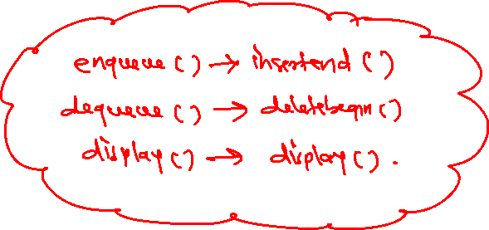
Program:
Write a program to implement queue using linked list
OR
Write a program to perform linked list implement of queue

Slide 41
Linked List Application: Polynomial Addition
Using linked list, we can perform different operations like addition, subtraction on polynomial equations
Every polynomial term consist of its coefficient and exponent, which can be stored inside node of linked list
To represent continuity among different terms, we use next pointer which is used to store address of next node
Using singly linked list, we can perform addition of 2 nodes which results in addition of 2 polynomials

Slide 42
Program:
Write a program to implement to perform addition of 2 polynomials using linked list

Slide 43

Graph:
A graph (G) is non-linear data structure which comprises of set of vertices V(G) and set of edges E(G) which are used to connect those vertices. Here G=(V, E)

Slide 44

Following are different types of graph:
1. Undirected Graph:
If different edges of graph do not have any direction, then it is called as Undirected graph

Slide 45

Complete Graph:
It is an undirected graph, in which every vertex has an dedicated edge to all other vertices.

Slide 46

2. Directed Graph:
If different edges of graph are having direction, then it is called as Directed graph

Slide 47

3. Weighted Graph:
If all edges are assigned some integer value, then it is called as Weighted graph

Slide 48
Representation of Graph:
A graph can be represented in computer memory using following 2 ways:
1. Sequential Representation (Array Representation):
In this, we represent a graph with the help of square matrix, having same order as that of number of vertices. Such matrix is called as “Adjacency Matrix (A)” and the matrix is formed as:
Aij
1, if there is edge between i to j
0, if there is no edge between i to j

Slide 49
2. Linked Representation (Adjacency List):
Here, a graph can be represented using linked list. A linked list contains different headers (start), same as that of different vertices of graph. Each header is connected to its adjacency list nodes for linked representation

Slide 50
Graph Traversal:
We can perform traversal of graph using following 2 techniques:
1. Depth First Search (DFS):
Algorithm:
Push starting node A into stack
Repeat step 3 and 4 until stack is empty
Pop the top node i.e., ‘n’ and process it
Push all the neighbors of ‘n’ into stack which are not visited
Stop

Slide 51
Program:
Write a program to implement DFS traversal

Slide 52
2. Breadth First Search (BFS):
Algorithm:
Insert starting node A into queue
Repeat step 3 and 4 until queue is empty
Delete the front node i.e., ‘n’ and process it
Insert all the neighbors of ‘n’ into queue which are not visited
Stop

Slide 53
Program:
Write a program to implement BFS traversal

Slide 54
Topological Sorting:
It can be performed only on directed graph
Each directed edge represents dependency
If there is an edge between A to B then B is depending on A, so A must be visited before B
Topological sorting can be performed on graph only if a graph contains at least one node with indegree 0.

Slide 55
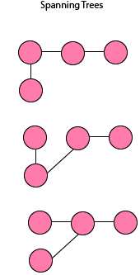
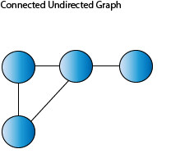
Spanning Tree and MCST
Given a connected graph, a spanning tree is a subgraph that is a tree, which should contain all connected vertices and should not form a cycle A single graph can have many spanning trees. Spanning Tree has (n-1) edges where n is the number of vertices

Slide 56
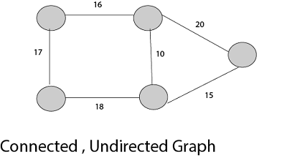
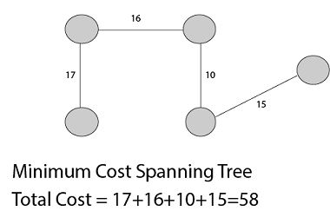
Minimum Cost Spanning Tree (MCST) is a Spanning Tree which has minimum total cost. The cost of spanning tree would be the sum of the cost of its edges.

Slide 57
Minimum Spanning Tree Algorithms:
Kruskal’s Algorithm:
Kruskal's Algorithm is used to find the minimum spanning tree for a connected weighted graph. Kruskal's algorithm follows greedy approach which finds an optimum solution at every stage.
Algorithm:
Remove all loops and Parallel Edges
Arrange all edges in their increasing order of weight
Add the edge which has the least weightage but ignore/reject those edges that create a cycle or closed loop
Add cost of every edge of spanning tree to get total cost

Slide 58
Prim’s Algorithm:
Prim's algorithm to find minimum cost spanning tree uses the greedy approach. Prim's algorithm, treats the nodes as a single tree and keeps on adding new nodes to the spanning tree from the given graph.
Algorithm:
Select starting vertex and consider all its directly connected edges
Select edge with minimum weight
Add the selected edge in spanning tree
Select vertex of added edge and repeat step 1 until all vertex has been selected

Slide 59
Shortest Path Algorithm:
Dijkstra’s Algorithm:
It is a greedy algorithm that solves the single-source shortest path problem for a directed graph with nonnegative edge weights
It is an algorithm that is used for finding the shortest distance, or path, from starting node to target node in a weighted graph
Algorithm:
1. Begin from the node to be selected, the source node, and it examines the entire graph to determine the shortest path among that node and all the other nodes connected to source node

Slide 60
2. Maintain the track of the currently recognized shortest distance from each node to the source code and updates these values if it identifies another shortest path.
3. Once the shortest path from the source code to another node is determined, the node is marked as “visited” and can be added to the path.
4. This process is being continued till all the nodes in the graph have been added to the path.

Slide 61
Sorting Techniques:
Insertion Sort:
Algorithm:
If the element is the first element, assume that it is already sorted.
Pick the next element and store it separately in a key.
Now, compare the key with all elements in the sorted array.
If the element in the sorted array is smaller than the current element, then move to the next element. Else, shift greater elements in the array towards the right.
Insert the key.
Repeat until the array is sorted.

Slide 62
Selection Sort:
Algorithm:
Set MIN to location 0
Search the minimum element in the list
Swap with value at location MIN
Increment MIN to point to next element
Repeat until list is sorted

Slide 63
Heap Sort:
A Binary Heap is a Complete Binary Tree where items are stored in a special order such that the value in a parent node is greater than the values in its two children's nodes
Algorithm:
Build a max heap from the input data.
At this point, the largest item is stored at the root of the heap. Replace it with the last item of the heap followed by reducing the size of heap by 1. Finally, heapify the root of the tree.
Repeat step 2 while the size of the heap is greater than 1.

Slide 64
Merge Sort:
Merge sort is a sorting technique based on divide and conquer technique. Merge sort first divides the array into equal halves and then combines them in a sorted manner.
Algorithm:
If it is only one element in the list it is already sorted, return.
Divide the list recursively into two halves until it can no more be divided.
Merge the smaller lists into new list in sorted order.

Slide 65
Quick Sort:
Divide: In Divide, first pick a pivot element. After that, partition or rearrange the array into two sub-arrays such that each element in the left sub-array is less than or equal to the pivot element and each element in the right sub-array is larger than the pivot element.
Conquer: Recursively, sort two subarrays with Quicksort.
Algorithm:
Choose the lowest index value has pivot
Take two variables to point down and up of the list excluding pivot
Down points to the first index and up points to the last index
While value at down’s value is less than pivot move down from left to right
While value at up’s value is greater than pivot move up from right to left
If both step 5 and step 6 does not match swap down’s value and up’s value
if down ≥ up, then swap up’s value with pivot

Slide 66
Radix Sort:
It is also called as Bucket Sort and in this, there is digit by digit sorting is performed that is started from the least significant digit to the most significant digit.
Algorithm:
max = largest element in the given array
d = number of digits in the largest element (or, max)
Create d buckets of size 0 - 9
for i -> 0 to d
sort the array elements using counting sort (or any stable sort) according to the digits at i^{th} place

Slide 67
Recursion:
It is a process of building a loop by calling a function itself
A termination condition is set to build limited number of iterations
The process of forwarding function call in recursion is called Winding and returning control back on returning value is called Unwinding
Types of Recursion:
1. Direct Recursion:
A function is called direct recursion if it calls the same function recursively

Slide 68
2. Indirect Recursion:
A function is called indirect recursion if it calls another function and that another function call a function directly or indirectly
3. Tail Recursion:
A recursive function is tail recursive when recursive call is the last thing executed by the function

Slide 69
Memory Allocation Methods:
1. First Fit:
In this approach, memory is allocated to first free partition or hole, which is large enough to accommodate the process. It finishes after finding the first suitable free partition
Advantage:
Fastest as it searches as little as possible
Disadvantage:
The remaining unused memory areas left after allocation become waste if it is too smaller

Slide 70
2. Best Fit:
It deals with allocating the smallest free partition which meet requirement of the requesting process. It first searches the entire list of free partition and consider the smallest hole that is adequate.
Advantage:
Memory utilization is much better than first fit as it search smallest free partition
Disadvantage:
It is slower and may tend to fill up memory with tiny useless holes

Slide 71
3. Worst Fit:
Worst fit approach is to locate largest available free partition so that the portion left will be big enough to be useful. It is reverse of best fit.
Advantage:
Reduce rate of production of small gaps
Disadvantage:
If a process requiring larger memory arrives at a later stage, then it cannot be accommodated as the largest hole is already split and occupied.

Slide 72
Given 5 memory partitions of 100KB, 500KB, 200KB, 300KB, 600KB (in-order). How would each of the First fit, Best fit and Worst fit algorithm place process of:
212KB, 417KB, 112KB, 426KB (in-order)

Slide 73
FIRST FIT
100 KB
500 KB
200 KB
300 KB
600 KB
BEST FIT
100 KB
500 KB
200 KB
300 KB
600 KB
WORST FIT
100 KB
500 KB
200 KB
300 KB
600 KB
P1=212 KB
P2= 417 KB
P3= 112 KB
P4= 426 KB

Slide 74
Fragmentation:
As processes are loaded and removed from memory, the free memory space gets generated
After allotment of processes, the unallotted, small sized partitions remains unused, this problem is known as “Fragmentation”
It has 2 types:
1. Internal Fragmentation:
It is used in Fixed sized partition, where partition size is fix
2. External Fragmentation:
It is used in Variable sized partition, where partition size is dependent upon size of processes

Slide 75
Threaded Binary Tree:
When we represent binary tree using linked list, mant times we get NULL pointers.
To minimize the number of NULL pointers in binary tree, we use Threaded Binary Tree

Slide 76
It can be performed with the help of following 2 types:
A. One-way threading:
In this, threading can be done either using left pointer or using right pointer. It has 2 types:
a. Left threaded tree:
In this, if a left pointer of particular node is NULL, it can create a thread to its in-order predecessor.

Slide 77
b. Right threaded tree:
In this, if a right pointer of particular node is NULL, it can create a thread to its in-order successor.

Slide 78
B. Two-way threading:
In this, if a left pointer of particular node is NULL, it can create a thread to its in-order predecessor and if right pointer of particular node is NULL, it can create a thread to its in-order successor.

Slide 79
Hashing:
It is a mechanism using which we can store data inside a particular storage
In this, the data which is to be stored is called as Key(K) and we need to store different keys inside a table called as Hash Table
In hashing, we need to apply different hash functions h(K) on different keys, which gives Hash Value on which we need to store a key inside hash table
A hash function should support following characteristics:
The hash value is fully determined by the data being hashed.
The hash function uses all the input data.
The hash function should be collision free.
The hash function generates very different hash values, even for similar data.

Slide 80
Hash Functions/ Hashing Methods
Following are different types of hash functions which are used to provide hash value
1. Modulo-Division Method (Remainder Method):
Here, we calculate hash value using following formula:
h(K)=K mod N, where N represents size of hash table and normally kept as prime number
Example: K1=11 and K2=12
Suppose N=3
h(K1)=11%3=2
h(K2)=12%3=0

Slide 81

2. Mid-square Method:
In this, we find the square of a key and consider middle digits of a square as hash value
Example: K1=11 and K2=12
${K1}^{2}=$121 h(K1)=2
${K2}^{2}=$144 h(K2)=4
3. Folding Method:
In this, we divide all digits of key into different folds, then we need to add all folds and the result of addition (ignoring carry) can be considered as hash value
Example: K1=123456789 and let Fold size=3
123
456
789
-------
1368 h(K1)=368

Slide 82
Collision Resolution Techniques:
A. Open Addressing:
It has 2 types:
1. Linear Probing:
In this, if collision occurs, then the hash value will be computed using:
h(K,i)=(K+i)%N
Here,
h: Hash function
K: Key
i: Number of collision
N: Size of hash table

Slide 83
2. Quadratic Probing:
In this, if collision occurs, then the hash value will be computed using:
h(K,i)=[h1(K)+C1*i+C2*i²]%N
Here,
h, h1: Hash functions
K: Key
i: Number of collision
N: Size of hash table
h1(K): K mod N
C1, C2: Constants where C1, C2 < N and C1, C2 != 0

Slide 84
B. Rehashing or Double Hashing:
In this, if collision occurs, then the hash value will be computed using:
h(K,i)=[h1(K)+i*h2(K)]%N
Here,
h,h1,h2: Hash functions
K: Key
i: Number of collision
N: Size of hash table
h1(K): K mod N
h2(K): K mod N’ choose N’=N-1 or N-2

Slide 85

Tree:
A tree is non-linear data structure, in which data can be represented in the form of nodes. A tree can contain root node, intermediate node as well as leaf node.

Slide 86

Binary Tree:
It is a type of tree in which every node should have maximum 2 children. It is also defined as a tree in which every node can be classified into root node, left subtree or right subtree.

Slide 87
Representation of Tree:
A tree can be represented in computer memory using following 2 ways:
1. Sequential Representation (Array Representation):
In this, we represent a tree with the help of single dimensional array.
In this, a root node at level 0 is assigned a sequence number 0 and then nodes at level 1 are assigned sequence number in ascending order from left to right and so on.

Slide 88
2. Linked Representation:
Here, a tree can be represented using linked list. A linked list contains different nodes having two pointers i.e., left and right
left pointer stores the address of left child of a node where right stores the address of right child of a node

Slide 89
Traversal in binary tree:
In binary tree, we can perform traversal i.e., visiting different nodes using following techniques:
Inorder traversal (LVR)
Preorder traversal (VLR)
Postorder traversal (LRV)

Slide 90
Applications of tree:
1. Expression tree:
We can create a binary tree for any given expression
In this, the operator of the expression will become parent node, left operand form left sub tree whereas right operand form right sub tree
While creating expression tree, we also need to consider the priority of operators, it means higher priority operators will get converted to expression tree prior to lower priority operators
It is the application of binary tree and hence every node should have maximum 2 children

Slide 91
2. Huffman tree:
Huffman encoding is mainly used to compress text using lossless compression techniques
To perform Huffman encoding on any input, we need to find the frequency of occurrence of every character in a text
The main idea is a character with high frequency should get replaced with less number of bits and a character with low frequency should get replaced with more number of bits

Slide 92
Algorithm:
Create a leaf node for each character at the character along with its frequency of occurrence in priority queue
Repeat step 3 to 5 till total number of nodes in a queue is greater than or equal to one node
Remove two nodes that have lowest frequency
Create a new node by merging two nodes with frequency equal to sum of two node frequency
Add newly created node to the primary queue
Reverse the process till we get individual character as leaf node, assign value 0 to left subtree and 1 to right subtree.
Read characters from root node to leaf nodes to generate Huffman tree

Slide 93
Binary Search Tree (BST):
It is a type of binary tree where the value of left child of node is less than or equal to its parent node whereas value of right child node is greater than its parent node. When we apply inorder traversal on BST we will get all elements in ascending order.

Slide 94
Creating BST:
Inputs: 7 24 16 44 3 2 20

Slide 95

Insertion in BST:
To perform insertion of new node in BST, we need to compare it with parent node and if its value is less than or equal to parent node, then add it to left subtree otherwise add it to right subtree

Slide 96

Deletion in BST:
1. Deletion of leaf node (node with 0 child):
A leaf node can directly be deleted from tree, without disturbing other nodes of tree

Slide 97

2. Deletion of node having single child:
If we wants to delete a node having single child, then its single child takes the position of deleted node

Slide 98

3. Deletion of node having two children:
If we wants to delete a node having two children, then its inorder traversal successor will take the position of deleted node

Slide 99

AVL Tree:
It is also called as Height Balanced tree
It is a special type of binary search tree, in which every node is height balanced i.e., height of every node should be in the range of {-1 , 0 , 1}
The height of node is the subtraction of height of left sub tree with height of right sub tree
H=HL-HR

Slide 100
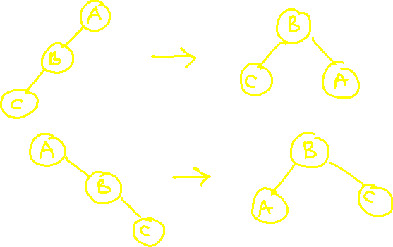
Many of times, different nodes do not fulfil the property of AVL tree, in that case we need to perform different rotations to convert it into AVL tree.
There are 4 types of rotations:
1. LL Rotation
2. RR Rotation

Slide 101
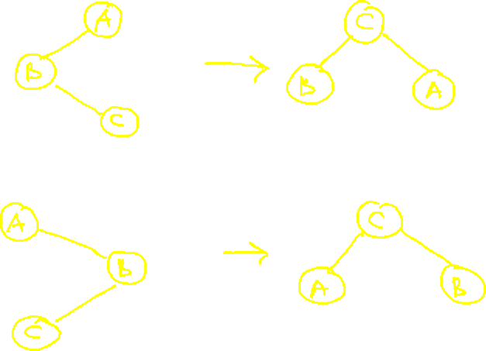
3. LR Rotation
2. RL Rotation

Slide 102
Create AVL tree for following inputs:
37 55 18 25 68 10 43 50 40 46 52 60

Slide 103
Create AVL tree for following inputs:
44 17 32 78 50 88 48 62 54

Slide 104
B Tree:
It is M-way tree and type of Binary Search Tree which grows upwards
In this, all leaf nodes should be present at the same level, and they are always balanced
If the order of B-Tree is N, then it should contain maximum N-1 data, and N number of keys which means each node can contain maximum N children.
All the data of the node should be present in ascending order

Slide 105
B+ Tree:
In B Tree, different elements are present in different levels
Hence, the record pointer which is used for searching should search all the levels from root node to leaf nodes
To overcome this, we must have all the elements in leaf nodes only
This can be done by performing following modifications on B-Tree:
When leaf node is split, middle value is sent up and its copy is also retained in the left child
All leaf nodes must be connected linearly
The B Tree with all these modifications is called as B+ Tree

Slide 106


